Slide 1
MEDICINE BOX
HANDWRITING RECOGNITION USING NEURAL NETWORKS
SILPA S PILLAI
S3 MCA
TVE20MCA-2050

Slide 2
PROJECT DESCRIPTION
The objective of this project is to implement handwriting recognition of doctors prescription
The project tries to develop an application where we can upload a prescription note from which we extract medicine name and will display it.
It provides low cost, deep learning mechanism for handwriting recognition.
It decrease the cases of misinterpretation of medicine names.
It helps ordinary people to understand doctors prescription.
Once input image of character is given to proposed system, then it will recognize input character which is given in image.

Slide 3
LITERATURE SURVEY
EXISTING SYSTEM
Deep learning algorithms to handwritten digit recognition using Deep Neural Network(DNN).
In this paper, we apply deep learning algorithms to handwritten digit recognition.
Explore the three mainstream algorithms of deep learning- Deep Neural Network (DNN).
Deep learning algorithm to the real-word handwritten character recognition using CNN and DBN.
Wu et al. have applied deep learning to the real-word handwritten character recognition, and obtained good performance for image recognition.
They analyzed the different between CNN and DBN by comparing the experiment results.
However, they did not consider the evaluation factors as execution time.
Recognition rate for handwritten digit recognition.
“Kaensar et al. have concluded that different classifier affects the recognition rate for handwritten digit recognition.
Accordingly, they applied three classification techniques by using the open source Weka tool kit for training and testing the dataset which was obtained from the UCI repository.
The presented results show that SVM is the best classifier to recognize handwritten digits.
However, the main problem of the SVM classifier is the time consuming of the training process

Slide 4
DISADVANTEGES OF EXISTING SYSTEM
Individual characters are recognized by ease with OCR.
Cursive handwriting, which is connected, poses more issues with evaluation. It is diﬃcult to interpret handwriting with no distinct separation between characters.
Time consuming.
Less accuracy.
Poor performance.
Takes more timing for prediction.
Did not consider the evaluation factors as execution time.

Slide 5
Proposed system
Provide a smart way to recognize the doctor’s prescription using deep machine learning.
The more accuracy of training data increases the performance of the application.
Help for those people who suffer while seeing the doctor’s prescriptions.
With Medicine Box, cases of misinterpretation of medicine names can be decreased.
Takes less time for training compared to existing system.
Expecting more accuracy than existing system.
User friendly

Slide 6
METHODOLOGY AND DESIGN
Our proposed system could be divided into five main steps:
• Preprocessing
• Segmentation
• Feature extraction
• Training
• Testing and detection

Slide 7
PREPROCESSING AND SEGMENTATION
PREPROCESSING
Read the picture file.
Decode the JPEG content to RGB grids of pixels with channels.
Rescale the pixel values (between 0 and 255) to the [0, 1] interval (as training neural networks with this range gets efficient).
We know that an image is 2D and represented as a matrix with 3 channels.
SEGMENTATION
After the preprocessing step, an image of medicine is decomposed into sub-images of individual medicines.
Preprocessed input image is segmented into isolated medicine name
In short cropping of individual drugs according to the RoI (Region of interest)
After segmentation CNN algorithm works.

Slide 8
CNN ARCHITECTURE
CONVOLUTION
The purpose of the convolution is to extract the features of the object on the image.
Convolution is an element-wise multiplication.
The concept is easy to understand.
Algorithm will scan a part of the image, usually with a dimension of 3×3(n*n) and multiplies it to a filter.
Filter is also called Kernel,(n*n)matrix.
The output of the element-wise multiplication is called a feature image.
This step is repeated until all the image is scanned.
Note that, after the convolution, the size of the image is reduced into multiple convolutional layers.

Slide 9
POOLING AND FULLY CONNECTED LAYERS
Pooling is easy to understand.
The purpose of the pooling is to reduce the dimensionality of the input image.
There are two types of Pooling:
Max Pooling and Average Pooling.
Max Pooling returns the maximum value from the portion of the feature image.
On the other hand, Average Pooling returns the average of all the values from the portion of the feature image.
Convolution and pooling continues multiple times and at last all the neurons from the previous layer fed into network layer(trained dataset) called dense layer , there happens testing and predict the output.

Slide 10

STRUCTURE OF CNN

Slide 11

CONVOLUTION OPERATOION
Here we have an input image and a kernel, typically it’s a 3*3 matrix.
We perform dot product between input matrix and the kernel to produce a third matrix which is the convolved feature.
User can determine how many number of convolution layers can be implemented on basis of the hand in task.
Convolved feature is also called as Activation Map or Feature Map, where the feature extraction takes place.
Each pixel value in convolved feature is not directly related to each weight value in the input image, this is called Local Connectivity property of convolution in CNN.

Slide 12
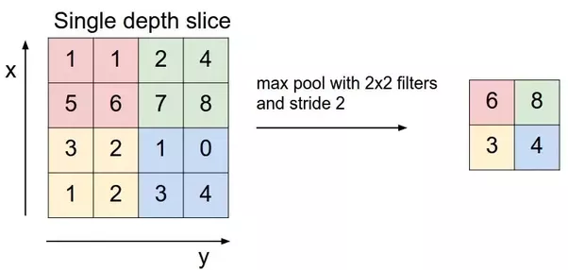
MAX POOLING IN CNN
Return maximum value in convolved feature from where the kernel overlaps.
Main aim is to reduce the dimensionality of the feature map.
Repeated process of convolution and pooling makes CNN better model for image processing.

Slide 13
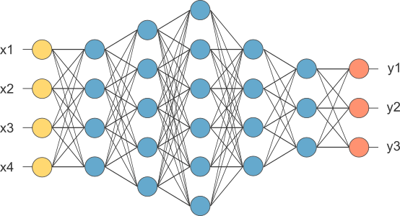
FULLY CONNECTED LAYERS
The layer we call as FC layer, we flattened our matrix into vector and feed it into a fully connected layer like a neural network.
The feature map matrix will be converted as vector (x1, x2, x3, …).
With the fully connected layers, we combined these features together to create a model.
Finally, we have an activation function such as Softmax or Sigmoid to classify the outputs.

Slide 14
ACTIVITY DIAGRAM
START
UPLOAD IMAGE
ERROR FOUND
PRE PROCESSING
IMAGE FORMAT NOT SUPPORTED
FORMAT ACCEPTED
SEGMENTATION
FEATURE EXTRACTION
TRAINING
TESTING & DETECTION
STOP

Slide 15
SYSTEM ARCHITECTURE
DATA
DATA PREPROCESSING
SEGMENTATION
TRAINING
DATA
TESTING
DATA
DETECTION
DEEP LEARNING
ALGORITHMS

Slide 16
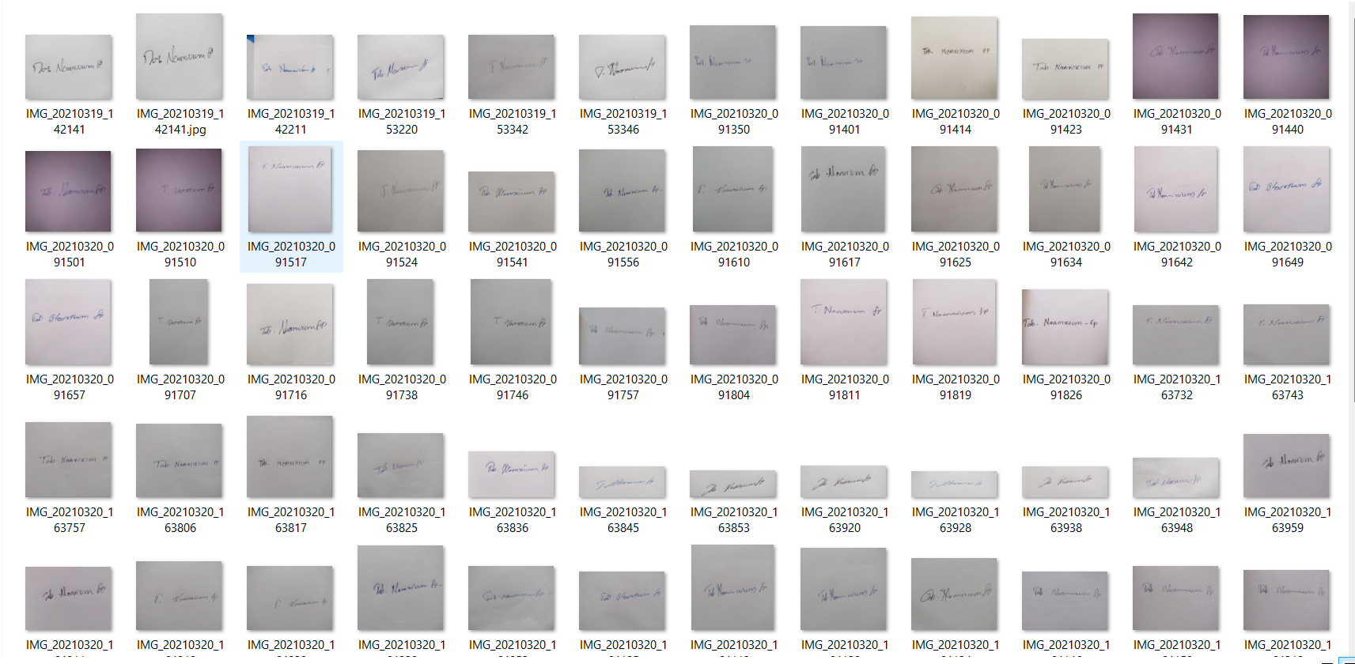
DATA SET MODEL

Slide 17
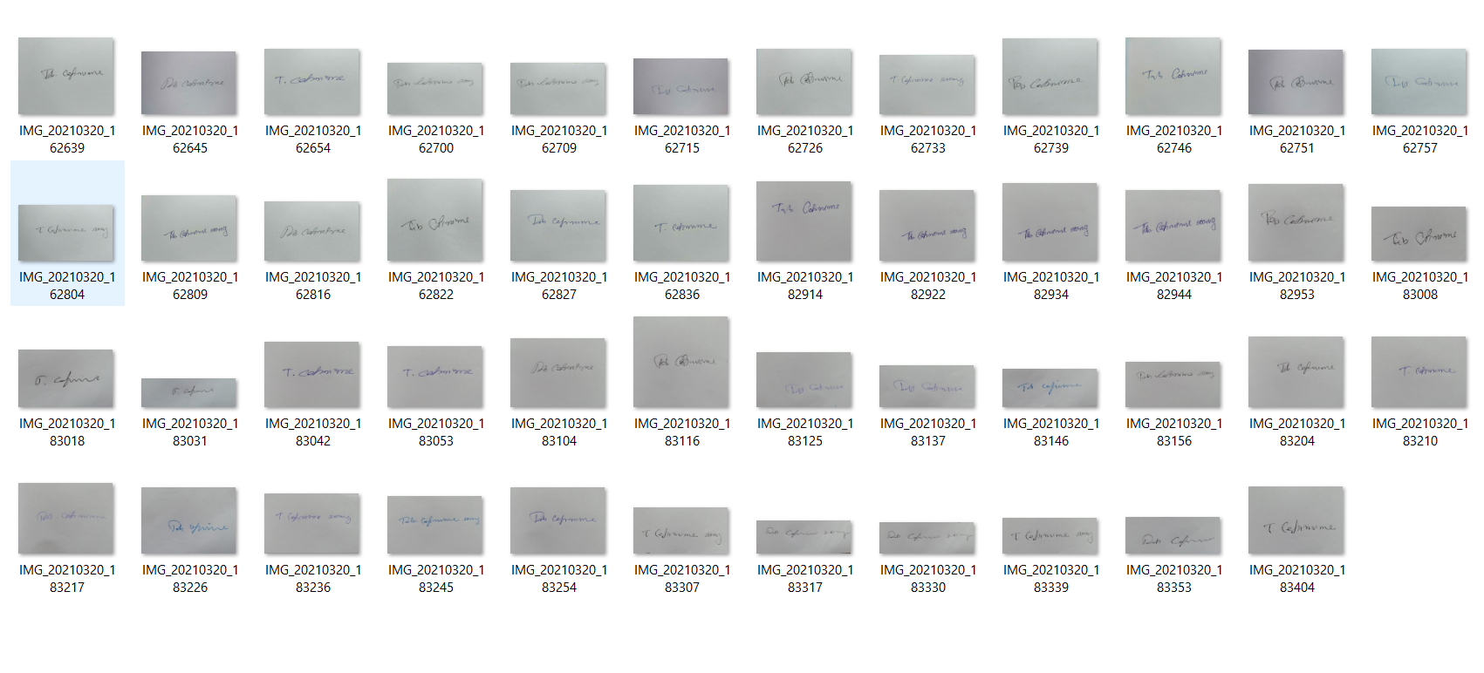
DATA SET MODEL

Slide 18
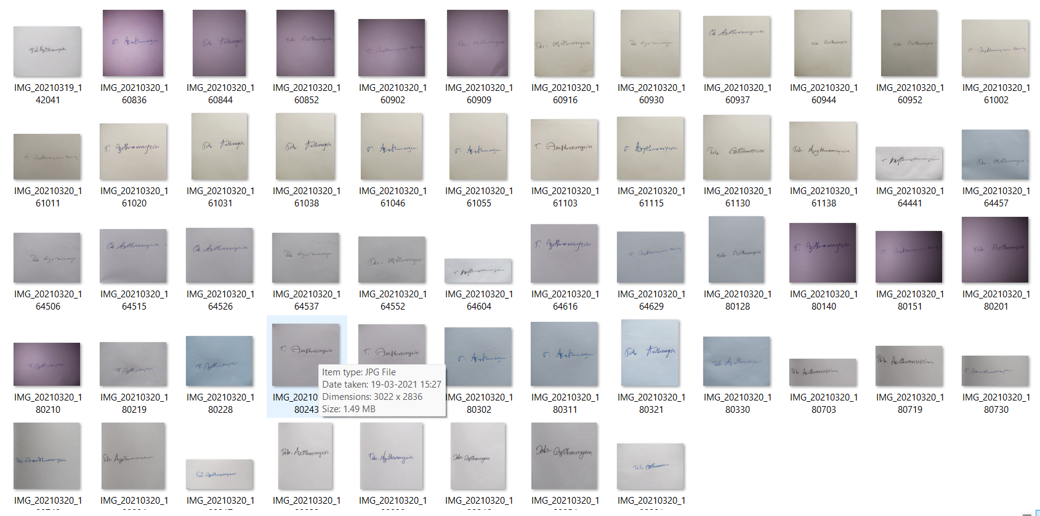
DATA SET MODEL

Slide 19
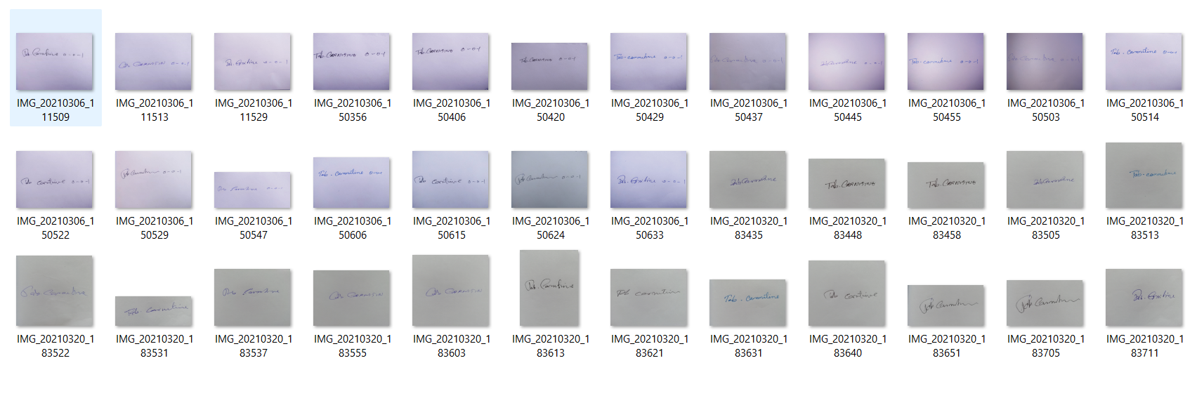
DATA SET MODEL

Slide 20
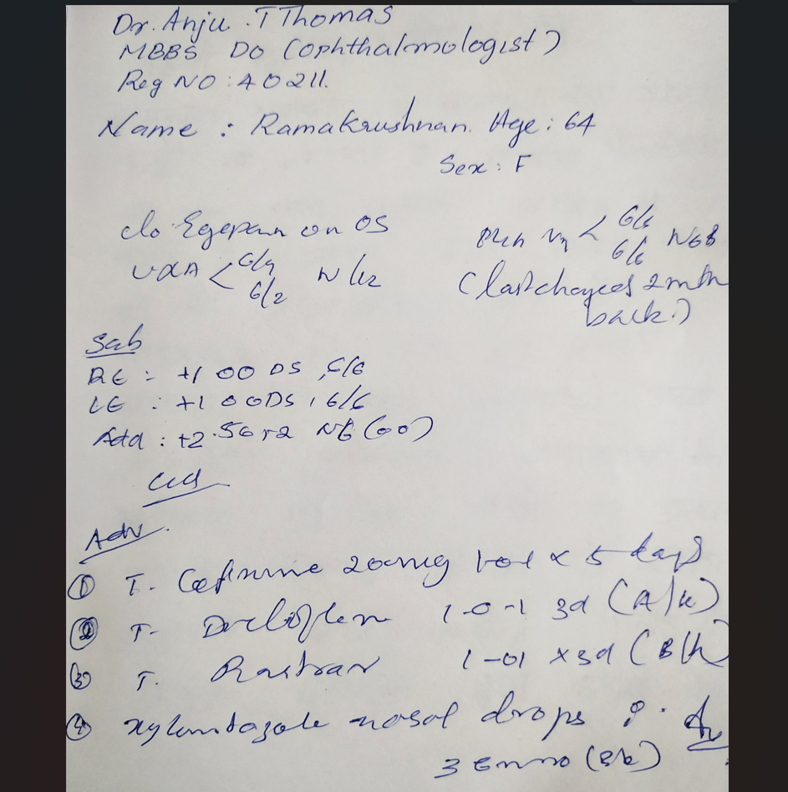
PRESCRIPTION DATA

Slide 21
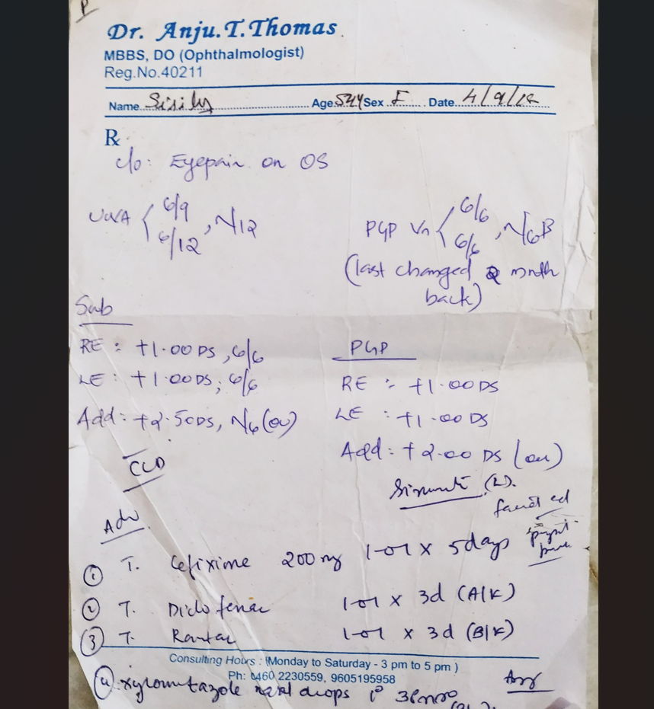
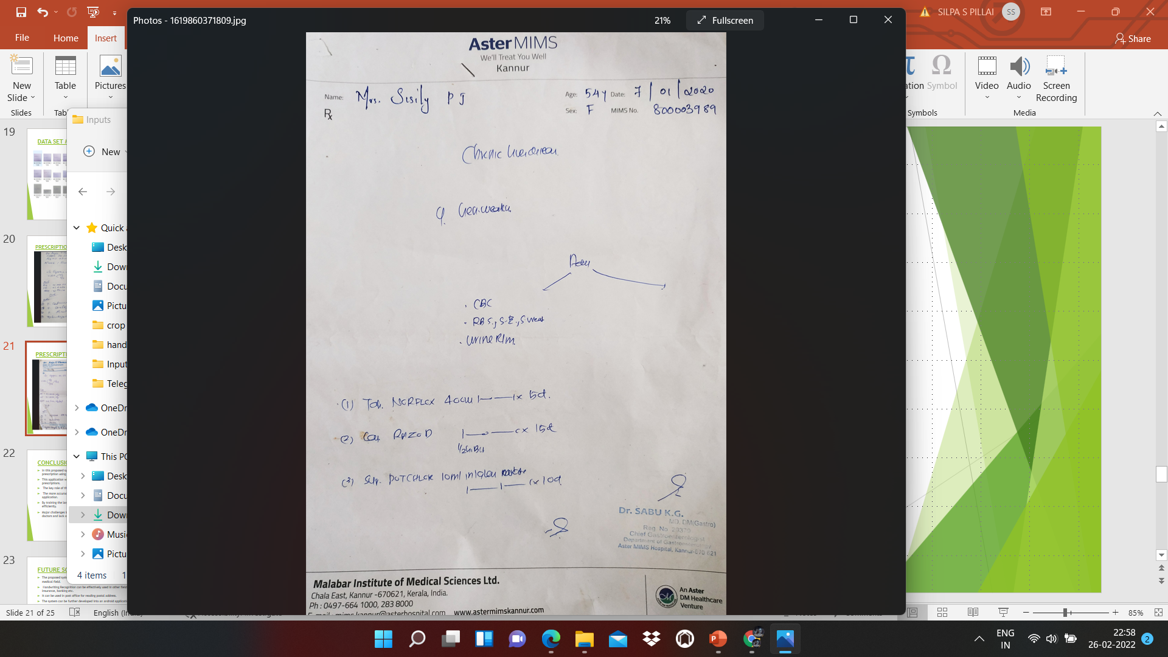
PRESCRIPTION DATA

Slide 22
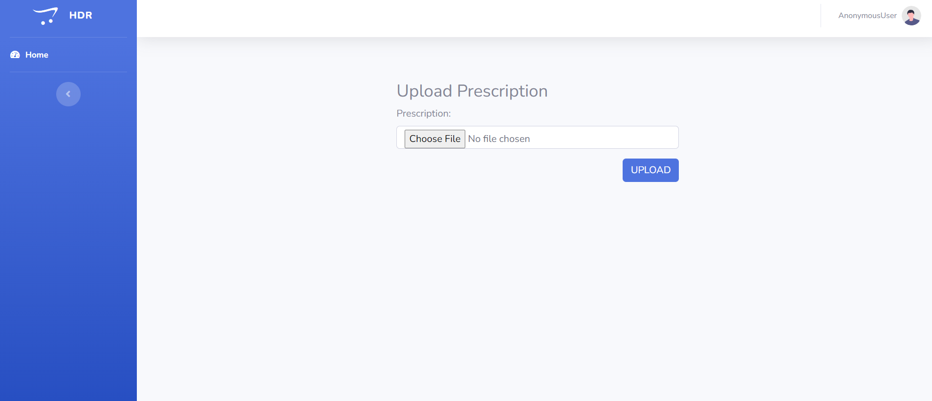
USER PAGE

Slide 23
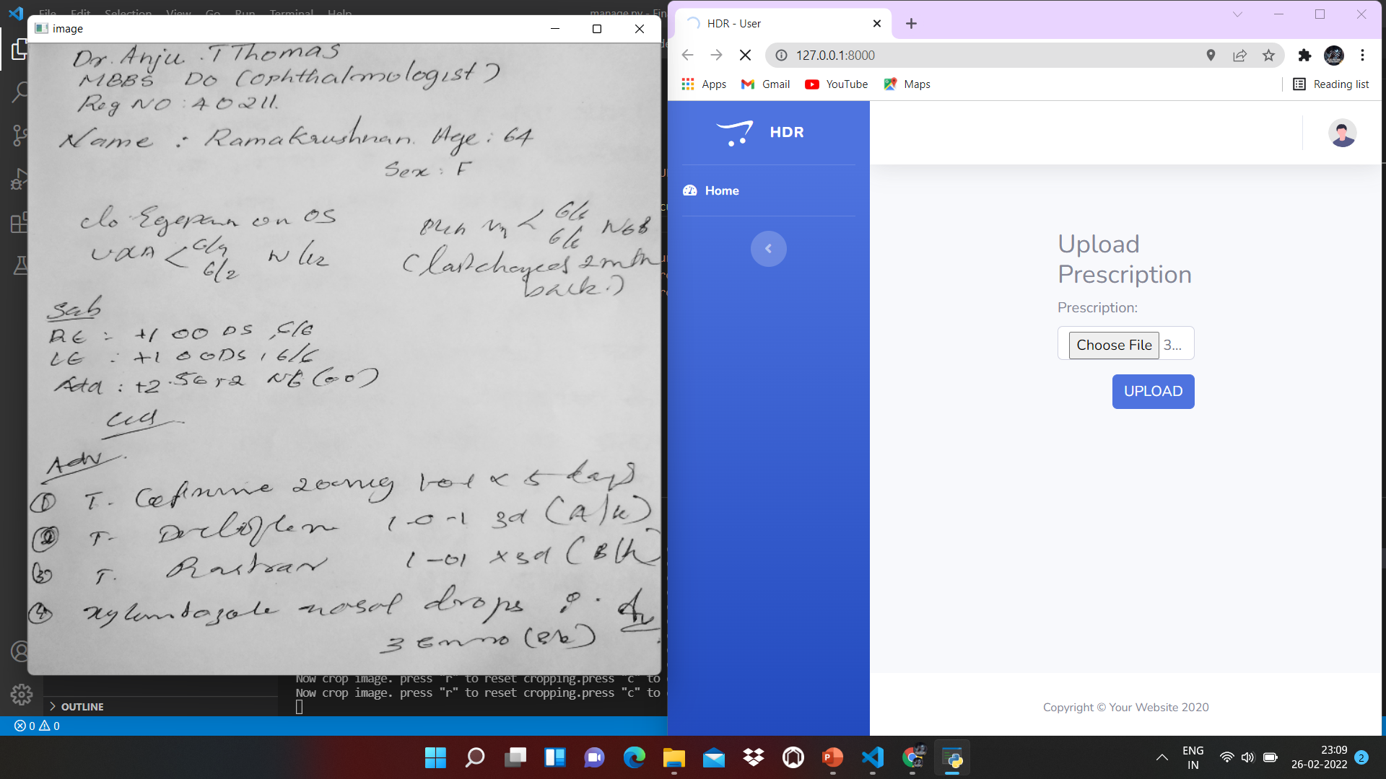
PRESCRIPTION UPLOAD

Slide 24
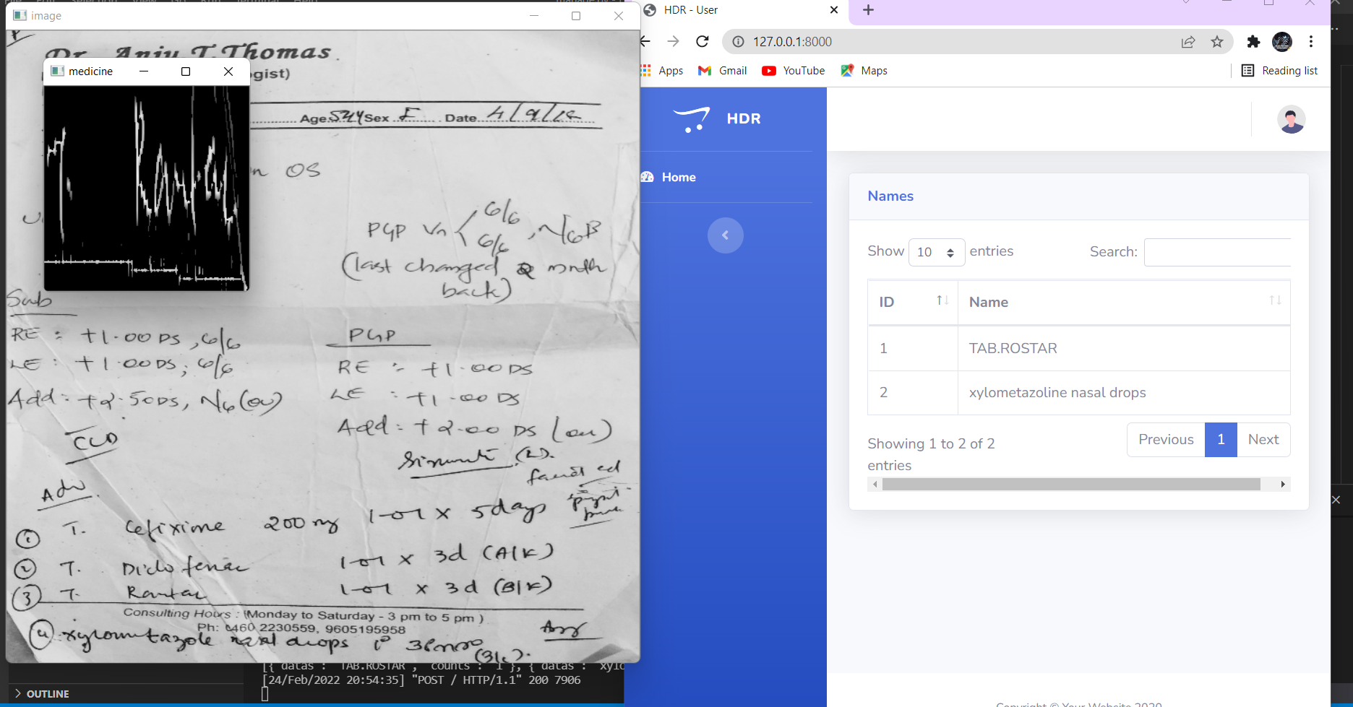
DRUG DETECTION

Slide 25
CONCLUSION
In this proposed system we provide a smart way to recognize the doctors prescription using deep machine learning.
This application will help for those people who suffer while seeing the doctors prescriptions.
The key role of this paper lies on data used for training purpose.
The more accuracy of training data increases the performance of the application.
By training the large data with large iteration we can perform the application efficiently.
Major challenges in designing this system is the different handwriting styles of doctors and lack of enough training data.

Slide 26
FUTURE SCOPE
The proposed system of handwriting recognition is concentrated only in medical field.
Handwriting Recognition can be effectively used in other fields like Insurance, banking etc.
It can be used in post office for reading postal address.
The system can be further developed into an android application.
The data in this system is small, in the future ,aim to validate our results by using big dataset and we can use another algorithm and compare the results and to predict more accurate results.
This work further extended to the character recognition for other languages.
In forensic application handwritten recognition will be an effective method for evidence collection

Slide 27
REFERENCES
Ting, R., S. Chun-lin, and D. Jian, “Handwritten character recognition using principal component analysis”. MINI-MICRO Systems, 2005.
Walid, R. and A. Lasfar. Handwritten digit recognition using sparse deep architectures. in Intelligent Systems: Theories and Applications (SITA-14), 2014 9th International Conference on. 2014. IEEE.
Attigeri, Savitha. "Neural Network based Handwritten Character Recognition system." International Journal of Engineering and Computer Science 7.03: 23761-23768, 2018.
Li, Z., et al. Handwritten digit recognition via active belief decision trees. in Control Conference (CCC), 2016 35th Chinese. 2016. IEEE

Slide 28
THANK YOU

